Slide 1
Visual Computing Praktikum
Predicting Spontaneous Synch Behavior of Starling Flocks using GAN

Slide 2
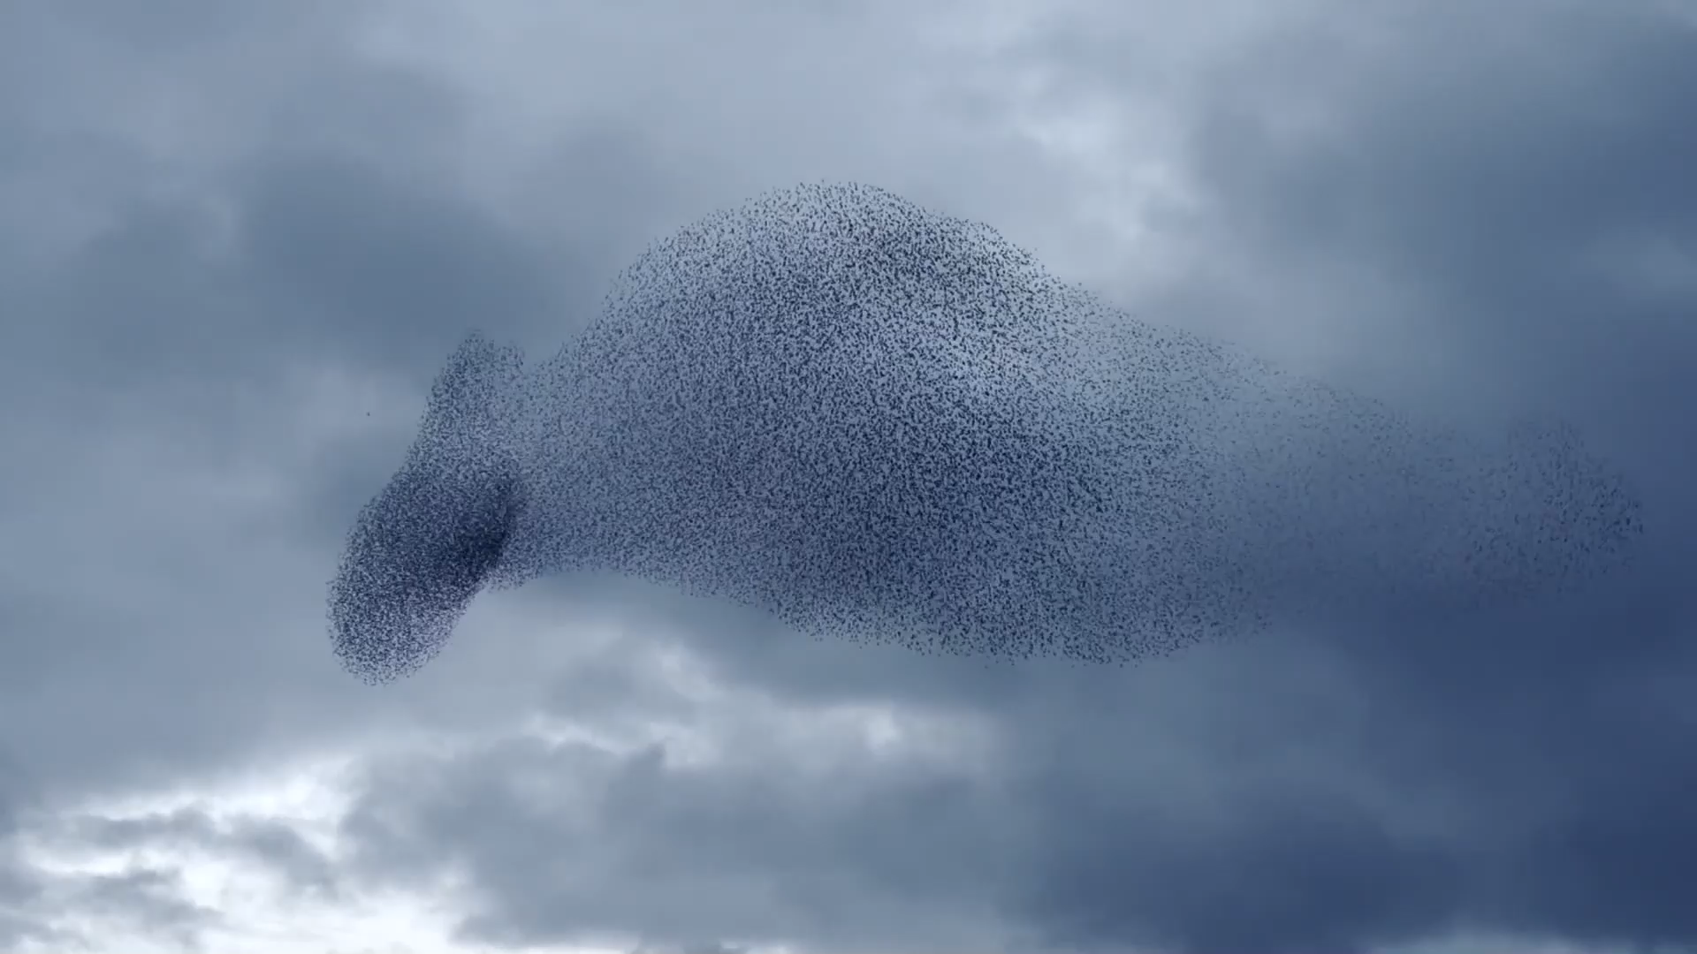
Motivation
Flocking behavior is a fascinating natural spectacle
The question arises how individual animals behave

Slide 3
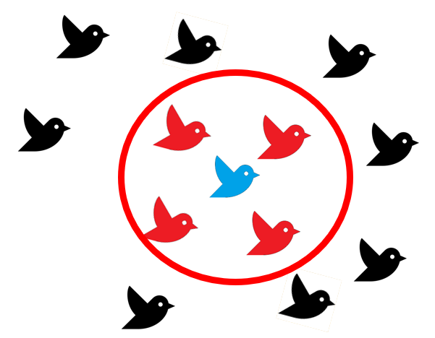
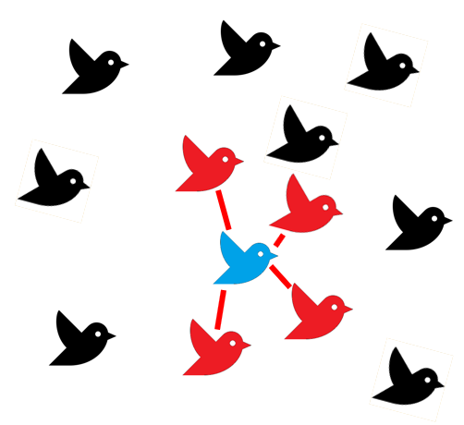
Hypotheses for bird interaction
Geometrical: Individuals base their movement decisions on neighbors inside a sphere around them
Topological: Individuals base their movement decisions on a fixed number of closest neighbors
Geometrical Topological
Lee, S-H., H. K. Pak, and T-S. Chon. "Dynamics of prey-flock escaping behavior in response to predator's attack." Journal of theoretical biology 240.2 (2006): 250-259.
Notes:
Alignment: hohes gewicht -> verhindert reaktion auf Angreifer
Usually 6-7 neighbors
Topological because observations showed: movement independent of flocks denisty
Lee, S-H., H. K. Pak, and T-S. Chon. "Dynamics of prey-flock escaping behavior in response to predator's attack." Journal of theoretical biology 240.2 (2006): 250-259.

Slide 4


Forces between birds
Alignment: adapt orientation and velocity
Attraction: Move torwards neighbors
Lee, S-H., H. K. Pak, and T-S. Chon. "Dynamics of prey-flock escaping behavior in response to predator's attack." Journal of theoretical biology 240.2 (2006): 250-259.
Notes:
Alignment: hohes gewicht -> verhindert reaktion auf Angreifer
Usually 6-7 neighbors
Topological because observations showed: movement independent of flocks denisty
Lee, S-H., H. K. Pak, and T-S. Chon. "Dynamics of prey-flock escaping behavior in response to predator's attack." Journal of theoretical biology 240.2 (2006): 250-259.

Slide 5

Forces between birds
Repulsion: Avoid Collisions with neighbors
Avoidance: Move away from predator
Lee, S-H., H. K. Pak, and T-S. Chon. "Dynamics of prey-flock escaping behavior in response to predator's attack." Journal of theoretical biology 240.2 (2006): 250-259.
Notes:
Alignment: hohes gewicht -> verhindert reaktion auf Angreifer
Usually 6-7 neighbors
Topological because observations showed: movement independent of flocks denisty
Lee, S-H., H. K. Pak, and T-S. Chon. "Dynamics of prey-flock escaping behavior in response to predator's attack." Journal of theoretical biology 240.2 (2006): 250-259.

Slide 6
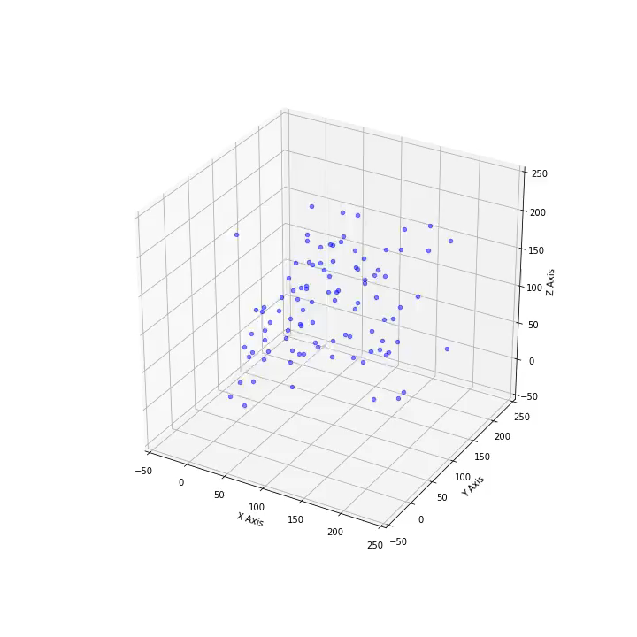
Simulator
Ruleset:
Alignment
Attraction
Repulsion
Avoidance
Additional Rules:
Keep Momentun
Stay inside world
Random noise

Slide 7
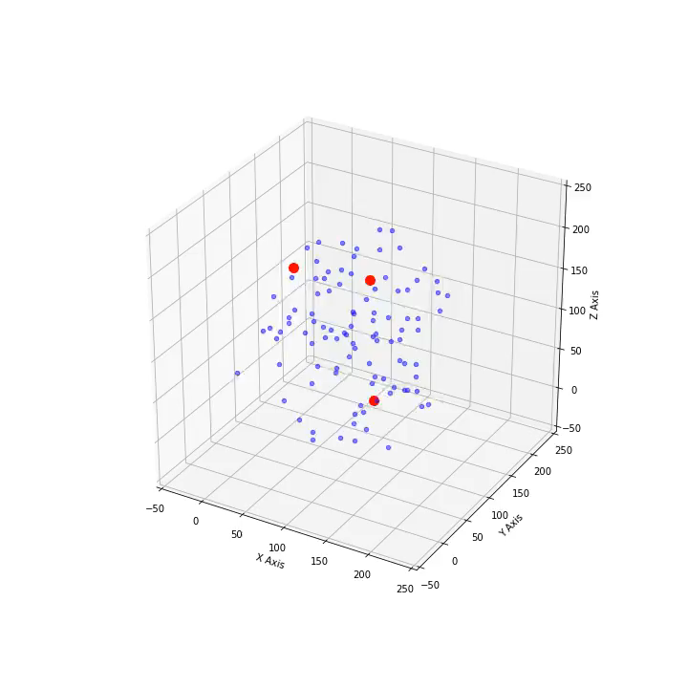
Simulator
Ruleset:
Alignment
Attraction
Repulsion
Avoidance
Additional Rules:
Keep Momentun
Stay inside world
Random noise

Slide 8
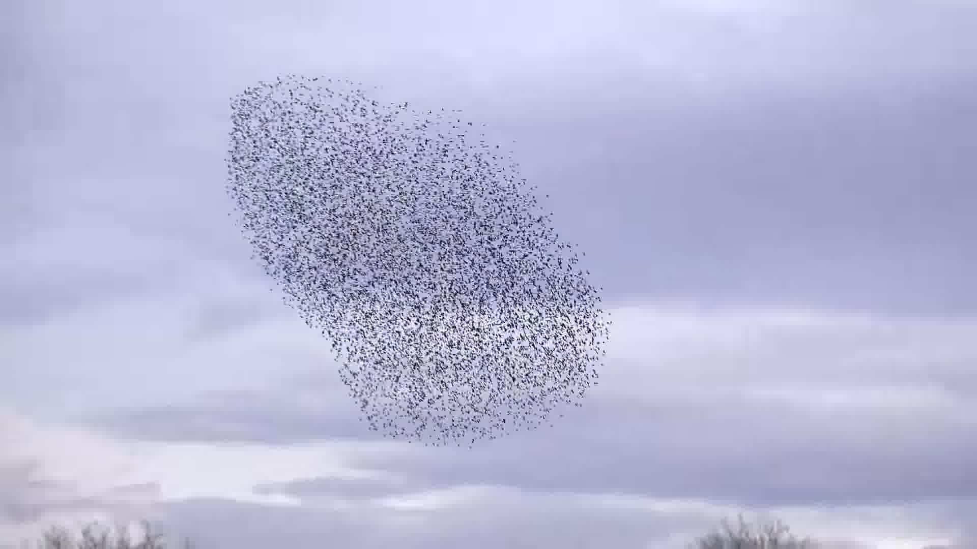
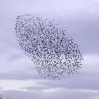
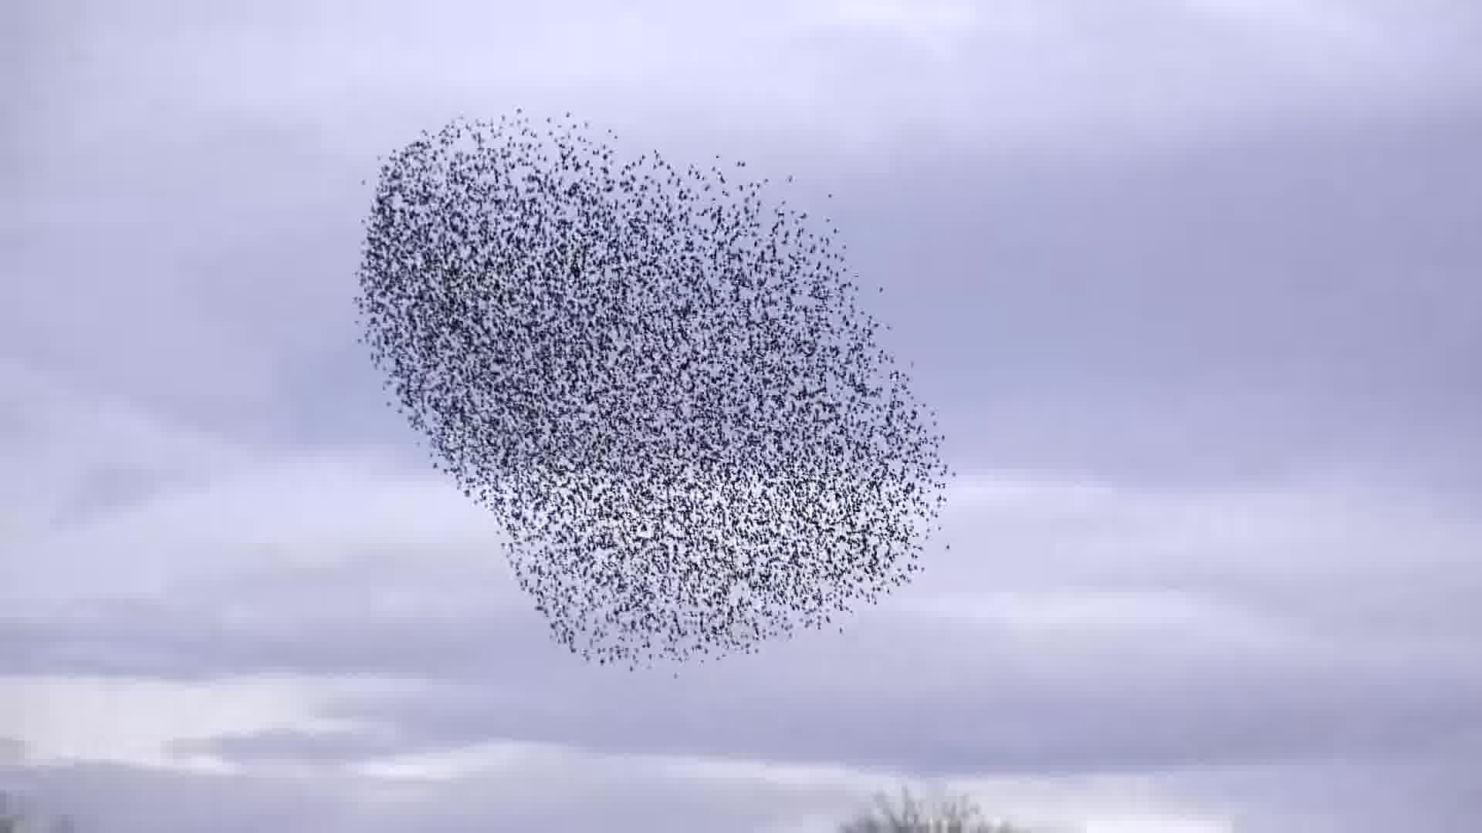
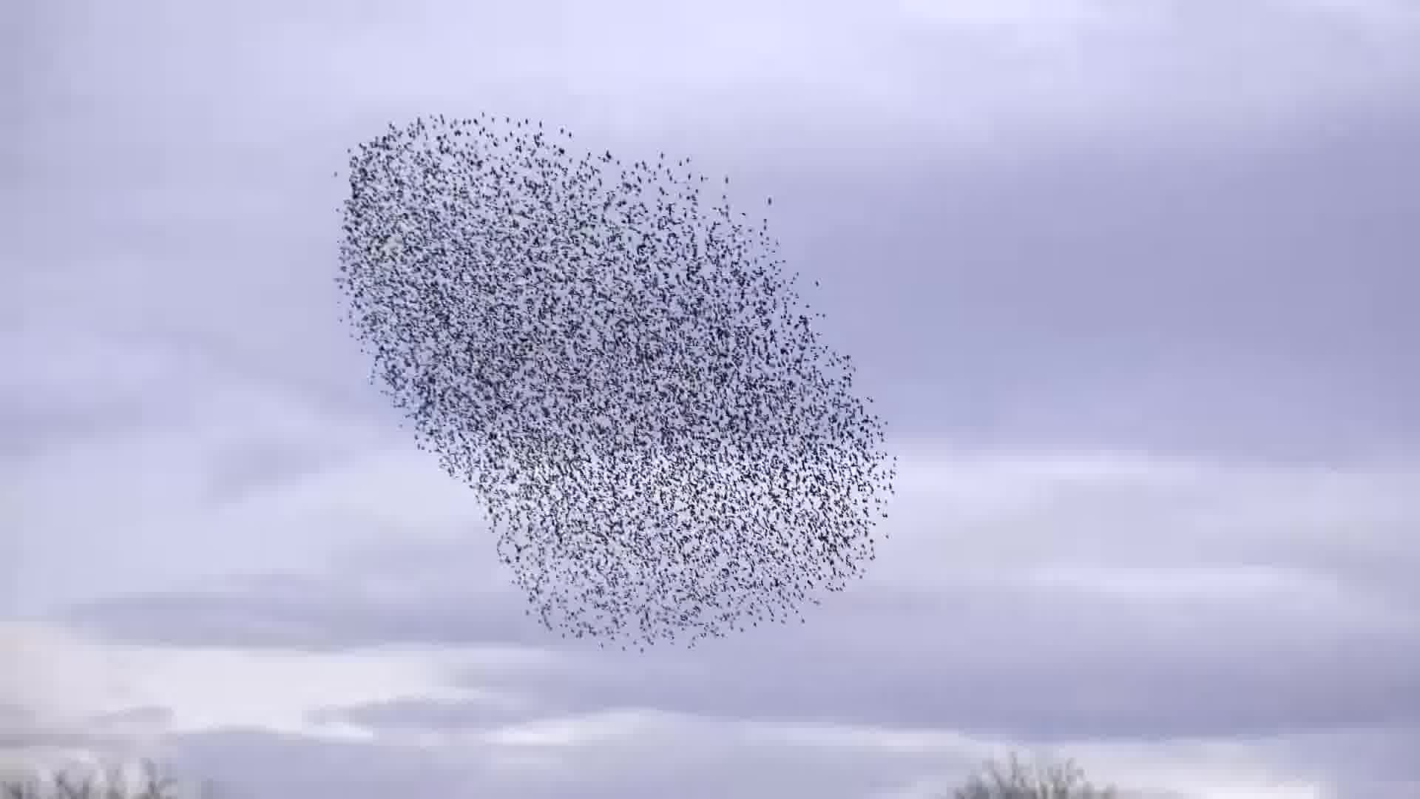
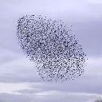
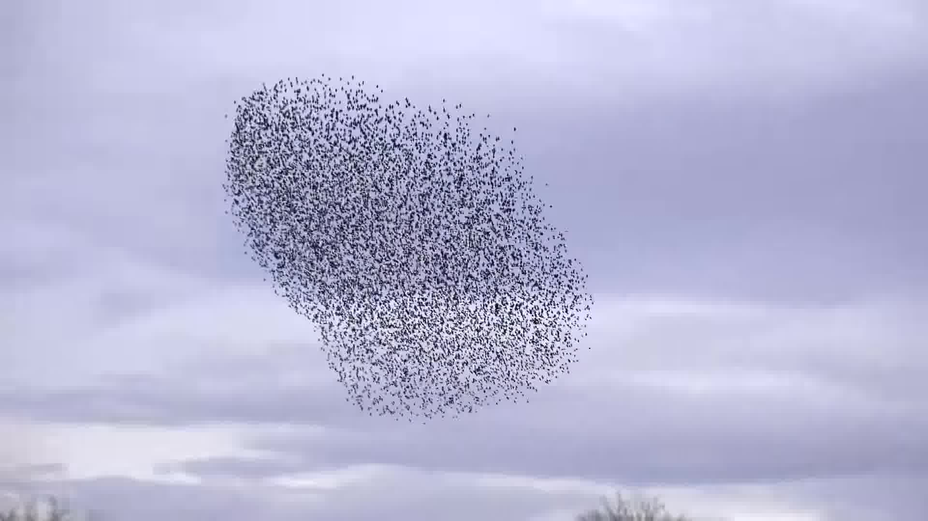
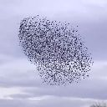
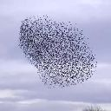

Building the Dataset
- Extracted from 13 YouTube Videos
- Split up into 5 FPS
- Cropped into frames of 512x512 pixels
- Final dataset contains 4300 images

Slide 9
GAN - Generative Adverserial Networks
Real World
Image
Discriminator
Real
Fake
Generator
Input
Fake Image
Zero-sum-game between two neural networks
Generator Network: Attempts to generate images which cannot be distinguished from real world images
Discriminator Network: Attempts to distinguish fake images from real images

Slide 10
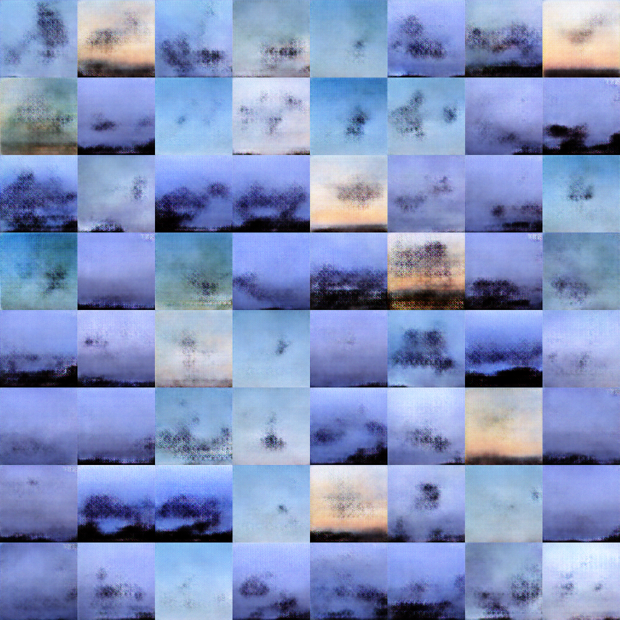
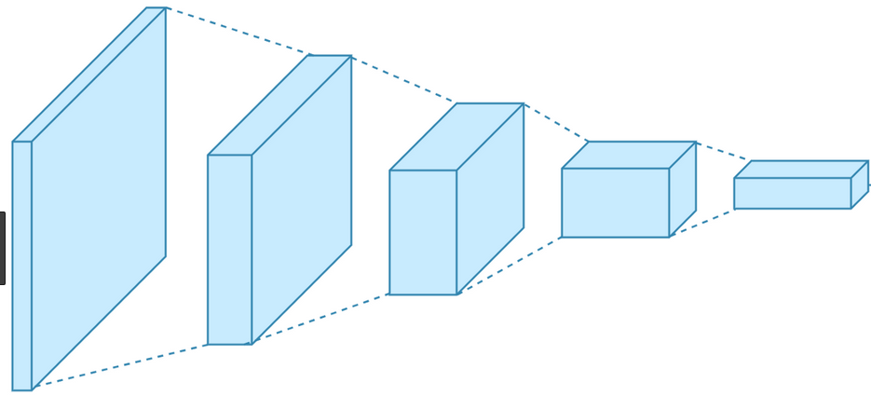
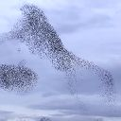
1st Approach: DCGAN
Generator (Deconvolution)
Discriminator (Convolution)
Real
Fake
Radford, Alec, Luke Metz, and Soumith Chintala. "Unsupervised representation learning with deep convolutional generative adversarial networks."
arXiv preprint arXiv:1511.06434 (2015).
Notes:
UNSUPERVISED REPRESENTATION LEARNING WITH DEEP CONVOLUTIONAL GENERATIVE ADVERSARIAL NETWORKS, Alec Radford & Luke Metz, Soumith Chintala, 2016

Slide 11
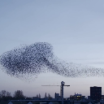
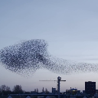
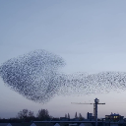
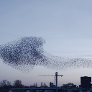
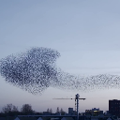
2nd Approach: Pix2Pix + LSTM
Input: 4 frames in 200ms intervals
Goal: Predict the image 1s after the last input image
LSTM
Layer
Convolution
Deconvolution
Isola, Phillip, et al. "Image-to-image translation with conditional adversarial networks." arXiv preprint (2017).
Notes:
Generator Loss: MAE
Discriminator Loss: binary crossentropy
DCGAN Loss: Binary Crossentropy + L1
Filter Sizes: Generator: Encoding 3x3, Decoding: 3x3, Activations: relu, lastone: tanh
Discriminator: 3x3, Activation: LeakyReLU, last one: Dense + softmax
LSTM is kind of recurrent network
Generator is Basically a UNet

Slide 12
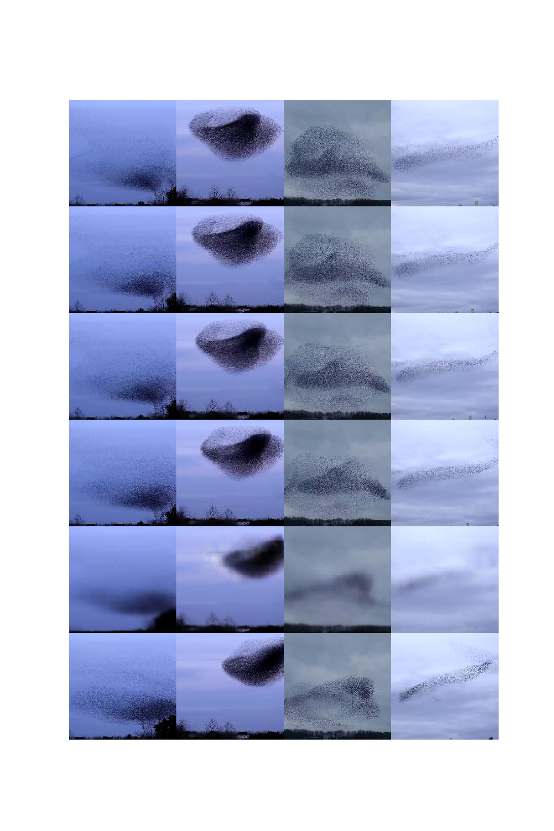
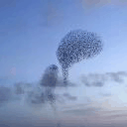
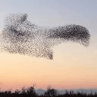
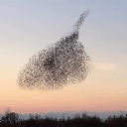
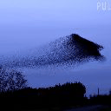
2nd Approach: Pix2Pix + LSTM
Input
Prediction
Ground Truth

Slide 13
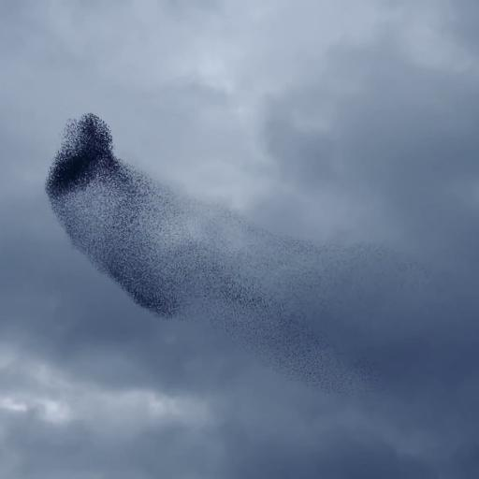
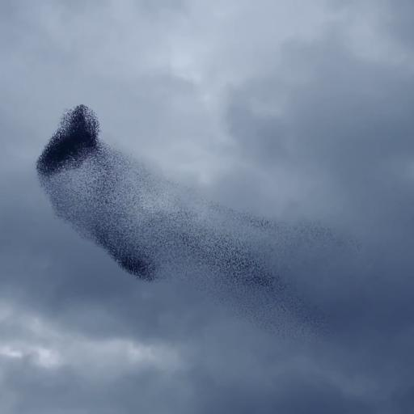
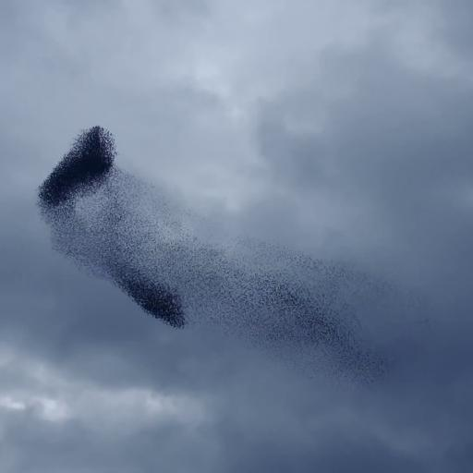
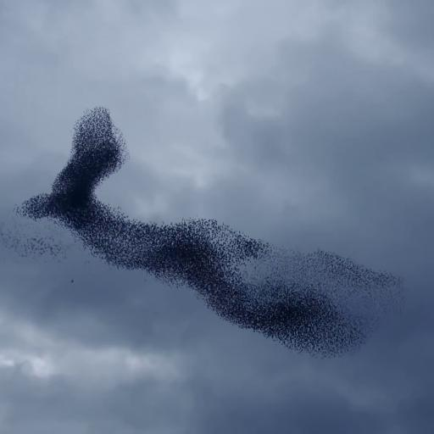
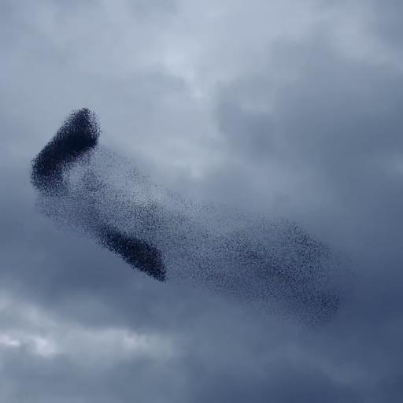
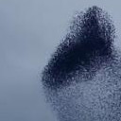
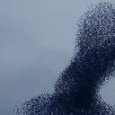
Super Resolution GAN
Local
Generator
Global
Generator
Downsampling
Input
Preprocessing
Pix2Pix Generators
Output

Slide 14
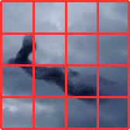
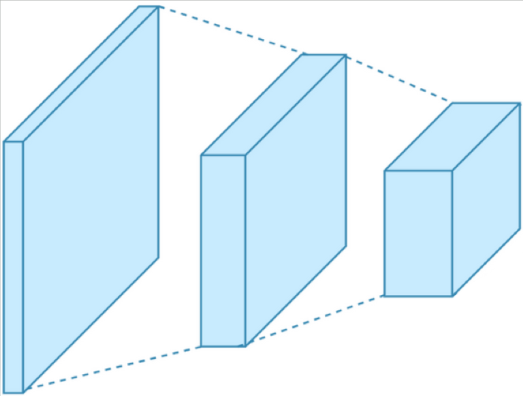
Super Resolution GAN
512x512
512x512
Concatenate
128x128

Slide 15
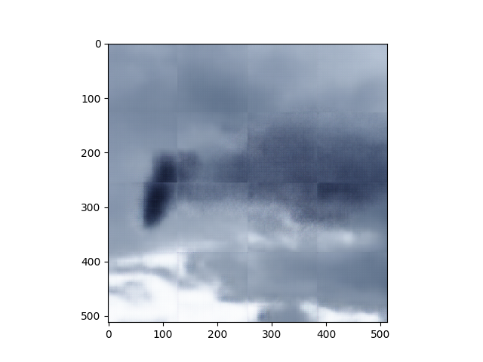
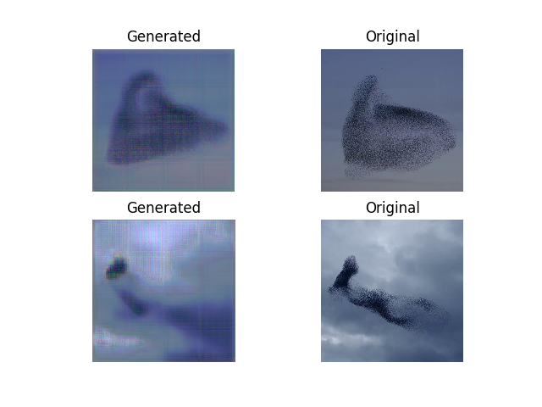
Super Resolution GAN - Results
Reconstructed Image from local patch predictions

Slide 16
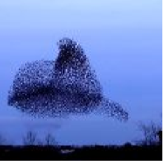
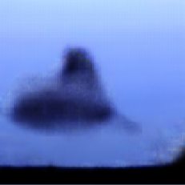
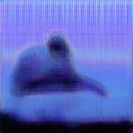
Final Results
Setup: 70% Train Instances
15% Validation Instances
15% Test Instances
 | Pix2Pix GAN | SR-GAN
PSNR | 24.27 | 21.53
SSIM | 0.683 | 0.401
Notes:
SSIM: Structural Similarity: measures similarity between two images based on human perceived quality

Slide 17
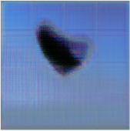
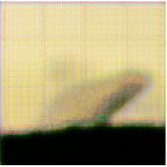
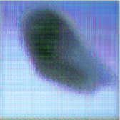
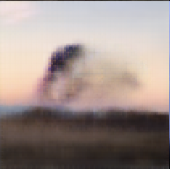
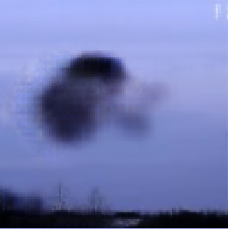
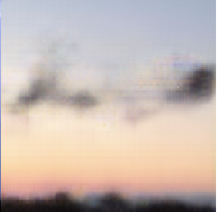
Conclusion
Pix2Pix GAN outperforms the SR-GAN approach
Future work for the SR-GAN:
Find a better metric to compare bird images
Improve the prediction quality of the local predictor
Evaluate different loss functions
Notes:
SSIM: Structural Similarity: measures similarity between two images based on human perceived quality

Slide 18
Thank you for your attention

Slide 19
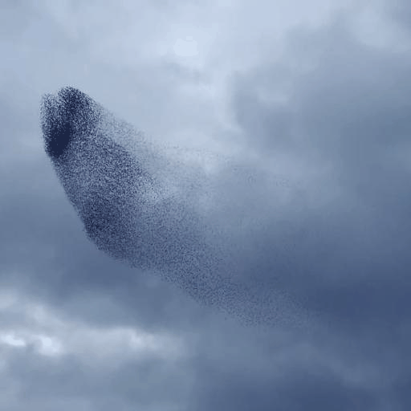
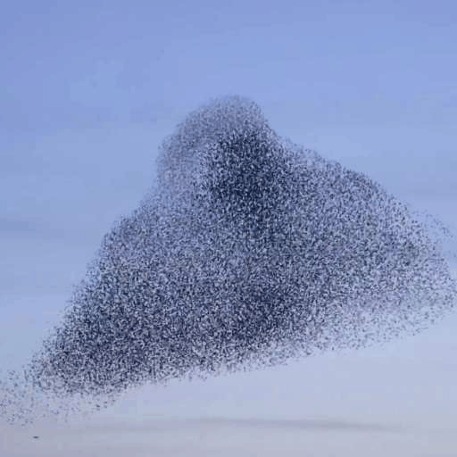
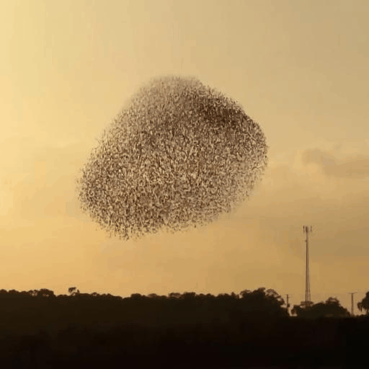
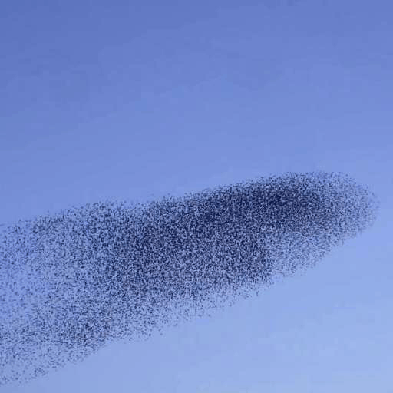
SRGAN

